Slide 1
ns-2 Network Simulator
Su Wen
Department of Computer Science
suwen@dcs.uky.edu

Slide 2

Background
VINT: Virtual InterNet Testbed
Intended audience
  Researchers, Developers, Educators
Users from approximately
  600 institutes
  50 countries
Releases
  Periodic releases (currently 2.1b7, Oct. 2000)
  Nightly snapshots (probably compiles and works, but “unstable”)
Notes:
Ns is developed for the VINT project,
it is intended give researchers, educator and developer a common platform for research.
Now ns has become the most popular network simulation tools used by researchers and developers alike.
A number of ns versions have been relased

Slide 3

What is NS
Discrete event simulator
  Object-oriented (C++, Otcl)
Simulates:
  Wired world
    Point-to-point link, LAN
    Unicast/multicast routing
    Transport
    Application layer
  Wireless
    Mobile IP
    Ad hoc routing
    Satellite network

Slide 4
Research Using NS
intserv/diffserv (QoS)
Multicast
  Routing
  Reliable multicast
Transport
  TCP
  Congestion control
Application
  Web caching
  Multimedia

Slide 5
Current Status
ns-2 (2.1b6) Simulator Core
  100K lines of C++
  70K lines of OTcl
  30K lines of test suite
  20K lines of documentation
Other Components
  Tcl/TK 8.x, OTcl, TclCL, nam-1
  Tcl-debug, GT-ITM, xgraph, …

Slide 6
ns Directory Structure
ns-allinone
Tcl8.0
TK8.0
OTcl
tclcl
ns-2
nam-1
tcl
...
C++ code
ex
test
lib
mcast
...
examples
validation tests
OTcl code

Slide 7
Platforms
Most UNIX and UNIX-like systems
  FreeBSD or *BSD
  Linux
  Sun Solaris
  HP, SGI
Window 95/98/NT
  Some work, some does not

Slide 8
Running simulations with ns
Compile the simulator core (“ns”)
Write a simulation script in Otcl
  e.g. my-test.tcl
Running the simulator
  e.g. ns my-test.tcl

Slide 9
Hello World
simple.tcl
  set sim [new Simulator]
  $sim at 1 “puts \“Hello World!\””
  $sim at 1.5 “exit”
  $sim run
arches 74% ns simple.tcl
Hello World!
arches 75%

Slide 10
Writing a Simulation Script
Create the event scheduler
[Turn on tracing]
Create network
Setup routing
[Insert errors]
Create transport connection
Create traffic
Transmit application-level data

Slide 11
Creating Event Scheduler
Create event scheduler
  set ns [new Simulator]
Schedule events
  $ns at <time> <event>
  <event>: any legitimate ns/tcl commands
    e.g [$ftp start]
Start scheduler
  $ns run

Slide 12
Writing a Simulation Script
Create the event scheduler
[Turn on tracing]
Create network
Setup routing
[Insert errors]
Create transport connection
Create traffic
Transmit application-level data

Slide 13
Tracing
Trace packets on all links
  $ns trace-all [open test.out w]
Must appear immediately after creating scheduler
Turn on tracing on specific links
  $ns trace-queue $n0 $n1
<event> <time> <from> <to> <pkt> <size> -- <fid> <src> <dst> <seq> <attr>
  + 1 0 2 cbr 210 ------- 0 0.0 3.1 0 0
  - 1 0 2 cbr 210 ------- 0 0.0 3.1 0 0
  r 1.00234 0 2 cbr 210 ------- 0 0.0 3.1 0 0

Slide 14
Writing a Simulation Script
Create the event scheduler
[Turn on tracing]
Create network
Setup routing
[Insert errors]
Create transport connection
Create traffic
Transmit application-level data

Slide 15
Creating Network
Nodes
  set n0 [$ns node]
  set n1 [$ns node]
Links and queuing
  $ns duplex-link $n0 $n1 <bandwidth> <delay> <queue_type>
  <queue_type>: DropTail, RED, CBQ, FQ, SFQ, DRR

Slide 16
Setup Routing
Unicast
  $ns rtproto <type>
  <type>: Static, Session, DV, cost, multi-path
Multicast
  $ns multicast (right after [new Simulator])
  $ns mrtproto <type>
  <type>: CtrMcast, DM, ST, BST

Slide 17
Network Topology: Node
n0
n1
Port Classifier
Unicast Node
Multicast Node
dmux_
Addr Classifier
classifier_
Node entry
Node entry
dmux_
entry_
entry_
Multicast Classifier
classifier_
multiclassifier_

Slide 18
Network Topology: Link
n0
n1
duplex link
n1 entry_
head_
enqT_
queue_
deqT_
link_
ttl_
tracing
drophead_
drpT_
simplex link

Slide 19
Writing a Simulation Script
Create the event scheduler
[Turn on tracing]
Create network
Setup routing
[Insert errors]
Create transport connection
Create traffic
Transmit application-level data

Slide 20
Inserting Errors
Creating Error Module
  set loss_module [new ErrorModel]
  $loss_module set rate_ 0.01
  $loss_module ranvar [new RandomVariable/Uniform]
Inserting Error Module
  $ns lossmodel $loss_module $n0 $n1
Link failures

Slide 21
Routing
n0
n1
Port Classifier
Addr Classifier
Node entry
0
n1 entry_
dmux_
head_
entry_
1
enqT_
queue_
deqT_
link_
ttl_
classifier_
drophead_
drpT_

Slide 22
Routing (con’t)
n0
n1
Port Classifier
Port Classifier
Addr Classifier
Addr Classifier
0
1
dmux_
Link n0-n1
dmux_
entry_
1
entry_
0
classifier_
classifier_
Link n1-n0

Slide 23
Writing a Simulation Script
Create the event scheduler
[Turn on tracing]
Create network
Setup routing
[Insert errors]
Create transport connection
Create traffic
Transmit application-level data

Slide 24
Creating Connection:
TCP
  set tcp [new Agent/TCP]
  set tcpsink [new Agent/TCPSink]
  $ns attach-agent $n0 $tcp
  $ns attach-agent $n1 $tcpsink
  $ns connect $tcp $tcpsink
UDP similar

Slide 25
Transport
n0
n1
Port Classifier
Port Classifier
dst_=1.0
dst_=0.0
Addr Classifier
0
Agent/TCP
Addr Classifier
0
Agent/TCPSink
agents_
agents_
0
1
dmux_
Link n0-n1
dmux_
entry_
1
entry_
0
classifier_
classifier_
Link n1-n0

Slide 26
Writing a Simulation Script
Create the event scheduler
[Turn on tracing]
Create network
Setup routing
[Insert errors]
Create transport connection
Create traffic
Transmit application-level data

Slide 27
Creating Traffic: On Top of TCP
FTP
  set ftp [new Application/FTP]
  $ftp attach-agent $tcp
Telnet
  set telnet [new Application/Telnet]
  $telnet attach-agent $tcp
CBR, Exponential, Pareto

Slide 28
Application: Traffic Generator
n0
n1
Port Classifier
Application/FTP
Port Classifier
dst_=1.0
dst_=0.0
Addr Classifier
0
Agent/TCP
Addr Classifier
0
Agent/TCPSink
agents_
agents_
0
1
dmux_
Link n0-n1
dmux_
entry_
1
entry_
0
classifier_
classifier_
Link n1-n0

Slide 29
Plumbing: Packet Flow
n0
n1
Port Classifier
Application/FTP
Port Classifier
dst_=1.0
dst_=0.0
Addr Classifier
0
Agent/TCP
Addr Classifier
0
Agent/TCPSink
0
1
Link n0-n1
entry_
1
entry_
0
Link n1-n0

Slide 30
Creating Traffic: Trace Driven
Trace driven
  set tfile [new Tracefile]
  $tfile filename <file>
  set src [new Application/Traffic/Trace]
  $src attach-tracefile $tfile
<file>:
  Binary format
  inter-packet time (msec) and packet size (byte)

Slide 31
Emulation in ns
Simulator ⬄ real network
  Inject received packets into simulation
  Emit packets on to live network
Usage
  Subject real implementations to controlled conditions in the simulator
  Subject simulations to real-world traffic
Currently only works on FreeBSD

Slide 32
Summary: Generic Script Structure
set ns [new Simulator]
# [Turn on tracing]
# Create topology
# Setup packet loss, link dynamics
# Create routing agents
# Create:
# - multicast groups
# - protocol agents
# - application and/or setup traffic sources
# Post-processing procs
# Start simulation

Slide 33
Cautions
People tried best to validate ns with regression tests
However: abstraction of the real world is necessary for a simulator
You must justify the usage of this simulator based on your research goals

Slide 34
Creating New Components
Extending ns in Otcl
  source your changes in your simulation scripts
Extending ns in C++
  Change Makefile (if created new files)
  make depend
  recompile

Slide 35
C++ Guidelines
Decide position in class hierarchy
  i.e., which class to derive from?
Create new packet header (if necessary)
Create C++ class, fill in methods
Define OTcl linkage (if any)
Write OTcl code (if any)
Build (and debug)

Slide 36
Class Hierarchy in ns
TclObject
NsObject
Connector
Classifier
Queue
Delay
Agent
Trace
AddrClassifier
McastClasifier
DropTail
RED
TCP
Enq
Deq
Drop
Reno
SACK
JS

Slide 37
TCP Jump Start – Step 1
New file: tcp-js.h
class JSTCPAgent : public TcpAgent {
public:
virtual void set_initial_window() {
cwnd_ = MAXWIN_;
}
private:
int MAXWIN_;
};

Slide 38
TCP Jump Start – Step 2
New file: tcp-js.cc
static JSTcpClass : public TclClass {
public:
JSTcpClass() : TclClass("Agent/TCP/JS") {}
TclObject* create(int, const char*const*) {
return (new JSTcpAgent());
}
};
JSTcpAgent::JSTcpAgent() {
bind(“MAXWIN_”, MAXWIN_);
}

Slide 39
TclObject: Hierarchy and Shadowing
TclObject
OTcl class
hierarchy
C++ class
hierarchy
TclObject
static JSTcpClass : public TclClass {
public:
JSTcpClass():TclClass("Agent/TCP/JS"){}
TclObject*
create(int,const char*const*)
{ return (new JSTcpAgent());}
};
Agent
Agent
Agent/TCP/JS
JSTcpAgent
_o123
*tcp
Agent/TCP/JS OTcl
shadow object
Agent/TCP/JS C++
object

Slide 40
TclObject: Creation and Deletion
Agent/TCP/JS
constructor
Agent/TCP
constructor
TclObject
constructor
invoke parent
constructor
invoke parent
constructor
create C++
object
complete
initialization
which C++
object to create?
– TclClass
complete
initialization
create OTcl
shadow object
OTcl
C++
TclObject (C++)
constructor
parent (Agent)
constructor
JSTCPAgent
constructor
invoke parent
constructor
invoke parent
constructor
do nothing,
return
bind variables
and return
bind variables
and return

Slide 41
TclObject::bind()
Link C++ member variables to OTcl object variables
C++
  TcpAgent::TcpAgent() {
    bind(“window_”, &wnd_);
    … …
  }
  bind_time(), bind_bool(), bind_bw()
OTcl
  set tcp [new Agent/TCP]
  $tcp set window_ 200

Slide 42
Initialization of Bound Variables
Initialization through OTcl class variables
  Agent/TCP set window_ 50
Do all initialization of bound variables in ~ns/lib/ns-default.tcl
  Otherwise a warning will be issued when the shadow object is created

Slide 43
Calling C++ functions from Otcl
OTcl
set tcp [new Agent/TCP]
$tcp advance 10
C++
int TcpAgent::command(int argc,
const char*const* argv) {
  if (argc == 3) {
    if (strcmp(argv[1], “advance”) == 0) {
    int newseq = atoi(argv[2]);
      ……
      return(TCL_OK);
    }
    }
  return (Agent::command(argc, argv);
}

Slide 44
TclObject::command()
OTcl space
$tcp send
no such
procedure
TclObject::unknown{}
$tcp cmd send
C++ space
TcpAgent::command()
Yes
match
“send”?
No
process and return
Invoke parent:
return Agent::command()

Slide 45
Calling Otcl functions from C++
OTcl
Agent/TCP instproc advance {num} {
set window_ [expr $window_ + $num]
return $window_
}
C++
Tcl& tcl = Tcl::instance();
char *result;
tcl.evalf(“%s advance %d”, name_, size);
result = tcl.result();
wnd_ = atoi(result);

Slide 46
EmbeddedTcl
How it works
  tcl2c++: provided by TclCL, converts tcl scripts into a C++ static character array
  Makefile.in:
  tclsh8.0 bin/tcl-expand.tcl tcl/lib/ns-lib.tcl | tcl2c++ et_ns_lib > gen/ns_tcl.cc

Slide 47
Summary
TclObject
  Unified interpreted (OTcl) and compiled (C++) class hierarchies
  Seamless access (procedure call and variable access) between OTcl and C++
TclClass
  The mechanism that makes TclObject work
Tcl: primitives to access Tcl interpreter

Slide 48
Extending ns in OTcl
ns-allinone
Tcl8.0
TK8.0
OTcl
tclcl
ns-2
nam-1
tcl
...
C++ code
ex
test
mysrc
lib
mcast
...
examples
validation tests
msg.tcl
OTcl code

Slide 49
Add Your Changes into ns
  source your changes in your sim scripts
Or
  add to tcl/lib/ns-lib.tcl
…
source ../mysrc/msg.tcl
  Change Makefile
  NS_TCL_LIB = \
  tcl/mysrc/msg.tcl \
  …
  Recompile

Slide 50
Scalability vs Flexibility
It’s tempting to write all-OTcl simulation
  Benefit: quick prototyping
  Cost: memory + runtime
Solution
  Control the granularity of your split object by migrating methods from OTcl to C++
Conventional Wisdom:
  C++ for “data”
    Per packet action
  OTcl for control
    Periodic or triggered action

Slide 51
THE Merit of OTcl
Program size, complexity
low
high
C/C++
OTcl
split objects
Smoothly adjust the granularity of scripting to balance extensibility and performance
With complete compatibility with existing simulation scripts

Slide 52
Object Granularity Tips
Functionality
  Per-packet processing → C++
  Hooks, frequently changing code → OTcl
Data management
  Complex/large data structure → C++
  One-time configuration variables → OTcl

Slide 53
Memory Conservation Tips
Avoid trace-all
Use arrays for a sequence of variables
  Instead of n$i, say n($i)
Avoid OTcl temporary variables
Use dynamic binding
  delay_bind() instead of bind()
  See object.{h,cc}

Slide 54
Memory Leaks
Purify or dmalloc, but be careful about split objects:
  for {set i 0} {$i < 500} {incr i} {
  set a [new RandomVariable/Constant]
  }
  It leaks memory, but can’t be detected!
Solution
  Explicitly delete EVERY split object that was new-ed

Slide 55
ns Wireless World
Ad hoc routing
Mobile IP
Satellite networking

Slide 56
Ad hoc Routing
Mac Layer: IEEE 802.11
Address Resolution Protocol (ARP)
Ad hoc routing protocols: DSDV, DSR,TORA, AODV
Radio Propagation Model
  Friss-space attenuation at near distances
  Two ray ground at far distances
Antenna: an omni-directional antenna having unity gain

Slide 57
Satellite Networking
Developed by Tom Henderson (UCB)
Supported models
  Geostationary satellites: bent-pipe and processing-payload
  Low-Earth-Orbit satellites
Example: tcl/ex/sat-*.tcl
Much in-development

Slide 58
MobileIP Support
Developed by Sun
  Require a different Node structure than the MobileNode
  Co-exists with wired world in ns
Standard MobileIP
  Home Agent, Foreign Agent, MobileHosts…
Example
  ~ns/tcl/ex/wired-cum-wireless.tcl

Slide 59
Visualization Tools
nam-1 (Network AniMator Version 1)
  Packet-level animation
  Well supported by ns
  Turn on tracing
    $ns namtrace-all [open test.nam w]
    $ns namtrace-queue $n0 $n1
xgraph
  Conversion from ns trace to xgraph format

Slide 60
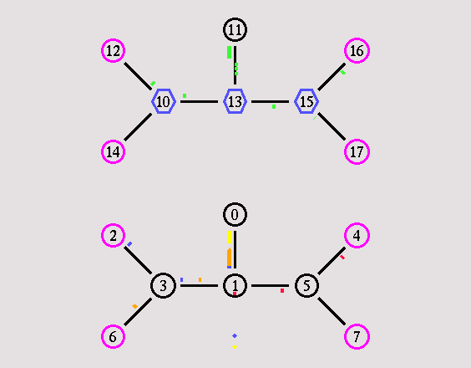
nam

Slide 61
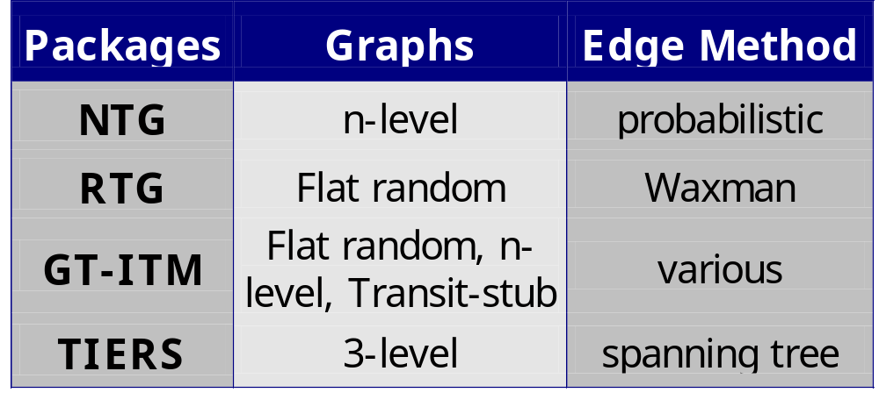
Topology Generation
http://www.isi.edu/nsnam/ns/ns-topogen.html

Slide 62
GT-ITM
Installation
  Comes with ns-allinone
  Require Knuth’s cweb and SGB
Usage
  itm <config_file>
Three graph models
  Flat random: Waxman
  n-level hierarchy
  Transit-stub

Slide 63
GT-ITM: Transit-Stub Model
transit
domains
transit-transit link
stub-stub link
stub
domains

Slide 64
Converters for GT-ITM
sgb2ns
  Convert SGB format to ns config file
  sgb2ns <SGB_file> <OTcl_file>
  ts2ns: output lists of transit and stub nodes
sgb2hier
  Convert transit-stub information into hierarchical addresses
  sgb2hierns <SGBFile> <TclFile>

Slide 65

Getting Help
ns-2 Webpage
  http://www.isi.edu/nsnam/ns/
ns-2 Mailing List
  ns-users@isi.edu
Tutorial Notes
  http://www.isi.edu/nsnam/dist/ns-workshop00

Slide 66
Installation
Getting the pieces
  Tcl/TK 8.x (8.0.5 preferred): http://dev.scriptics.com
  OTcl, TclCL, ns-2, nam-1: http://www.isi.edu/nsnam/dist
Other utilities
  http://www.isi.edu/nsnam/ns/ns-build.html
  Tcl-debug, GT-ITM, xgraph, …

Slide 67
Resources
Tcl (Tool Command Language)
  http://dev.scriptics.com/scripting
OTcl (MIT Object Tcl)
  ~otcl/doc/tutorial.html (in distribution)
ns manual
  Included in distribution: ~ns/doc
  http://www.isi.edu/~salehi/ns_doc.ps.gz

Slide 68
Final Word
My extended ns dumps OTcl scripts!
  Find the last 10-20 lines of the dump
  Is the error related to “_o*** cmd …” ?
    Check your command()
  Otherwise, check the otcl script pointed by the error message

